Slide 1



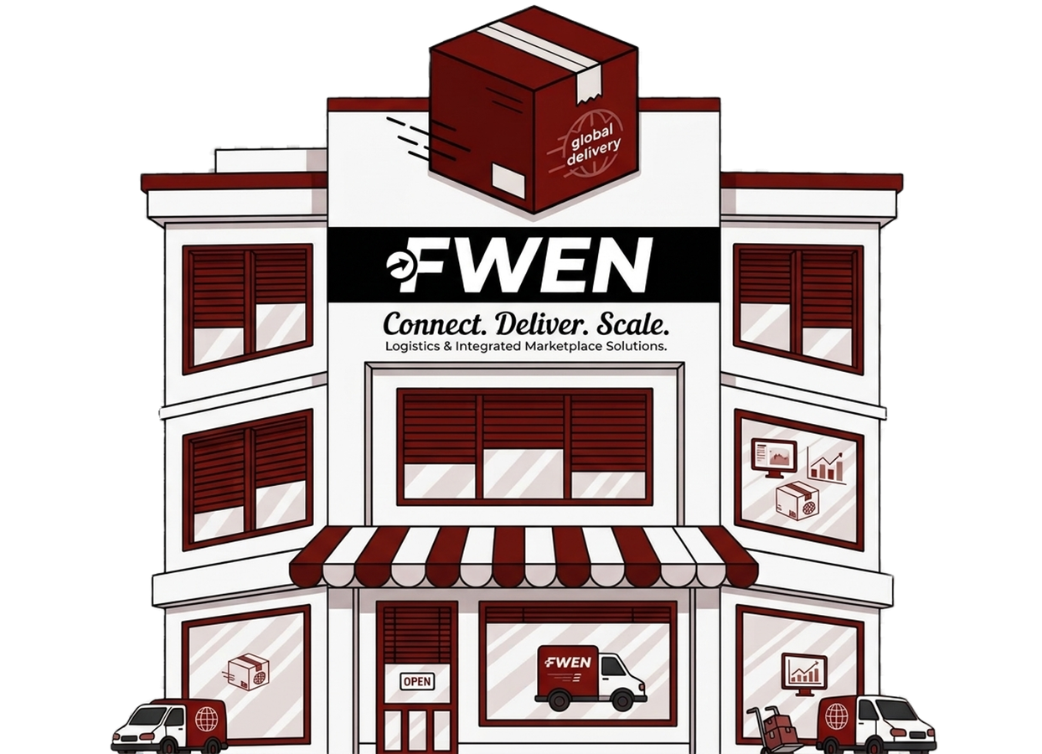

Olist Presentation
Olist Seller Evaluation & Reseller Business Analysis
Nouf Almutawea - DSB3
Fatema Butaher - DSB3
Fatema Shaker - DSB3

Slide 2
Agenda
About
Problem Statement
Objectives
Analysis
Recommendation

Slide 3
About FWEN
FWEN specializes in e-commerce and cargo analytics. We help businesses identify problems, understand what can be improved, and find practical solutions. From e-commerce platforms to internal business systems, we provide recommendations that help businesses improve their operations and overall performance.

Slide 4
Problem Statement
Between 2017 and 2018 in Brazil, Olist faced inconsistencies in sellers performance across sales, revenue, and customer satisfaction, while lacking a clear understanding of what distinguishes successful sellers. This may negatively affect customer experience and business performance, creating a need to better understand its seller base and identify opportunities to increase profitability.

Slide 5



Objectives
Identify successful and underperforming sellers
Evaluate seller acquisition and conversion rates
Compare seller types and their performance
Identify factors associated with seller success
Recommend solutions to improve seller selection

Slide 6
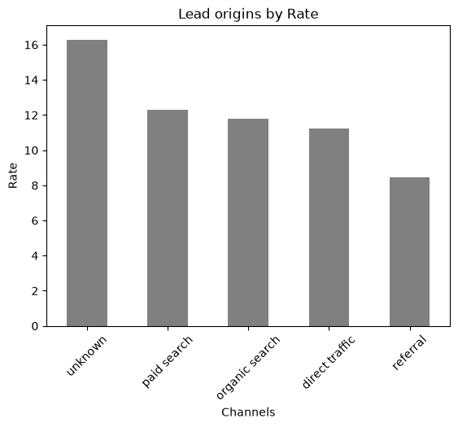
Seller Acquisition & Lead Conversion
8000
Qualified Leads
842
Became Sellers
10.5 %
Conversion Rate

Slide 7
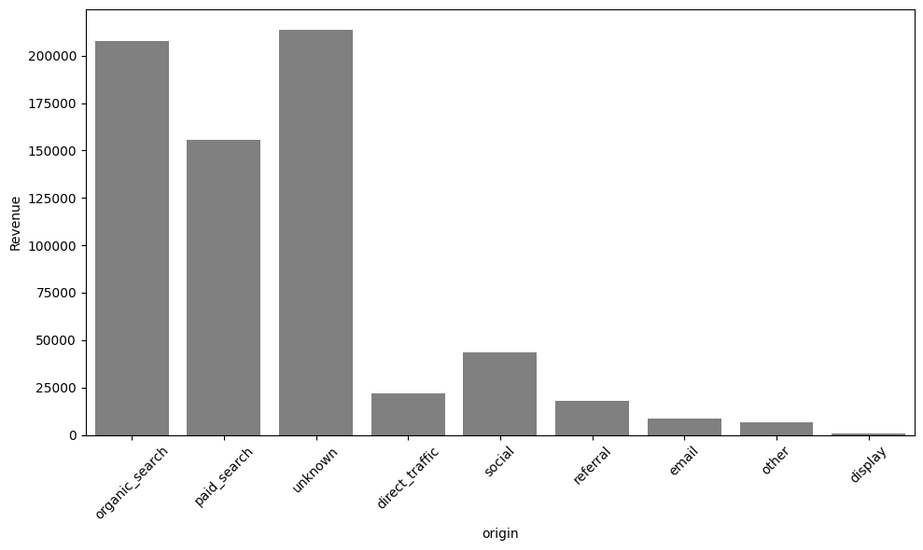
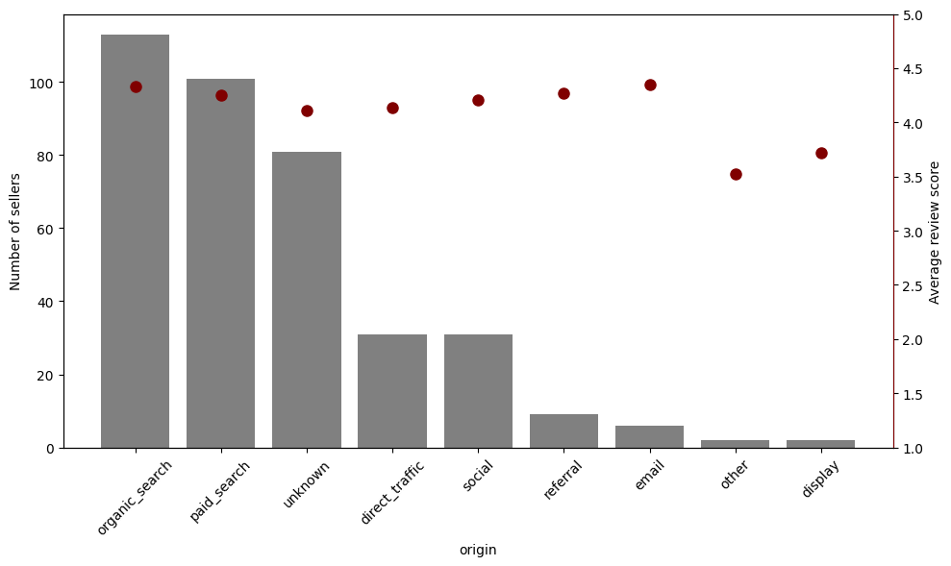
Seller Retaining Channels

Slide 8
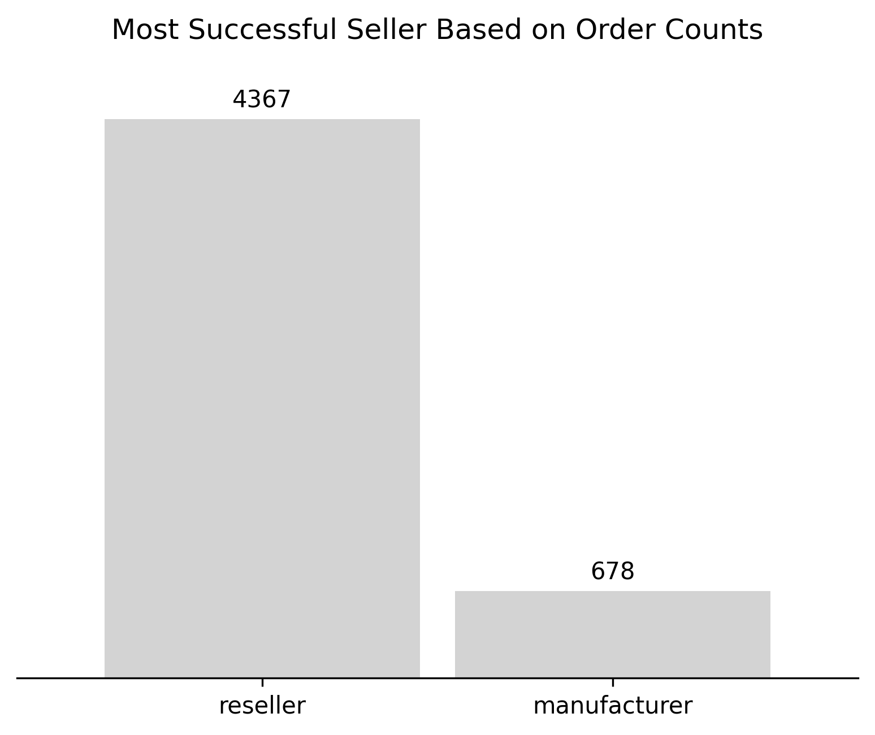

ر
Number of Sellers

Slide 9
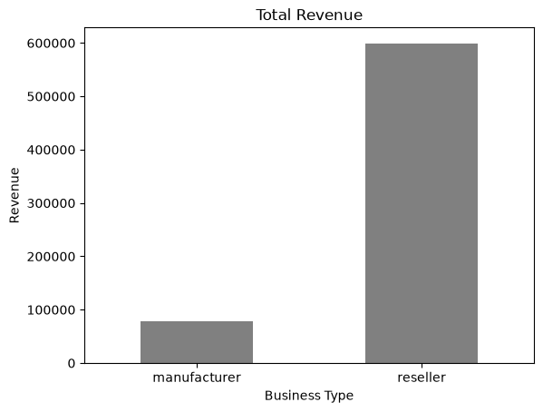
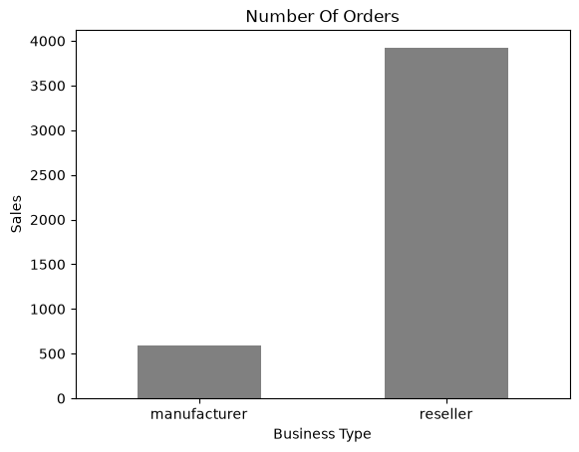
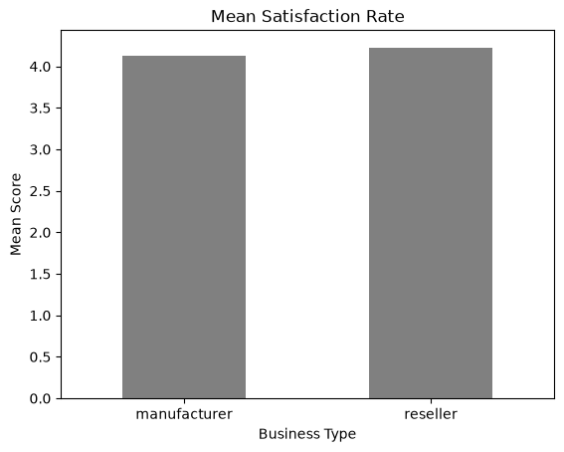


Resellers and Manufacturer Performance
Sum
Count
Average
Revenue
Sales
Satisfaction

Slide 10
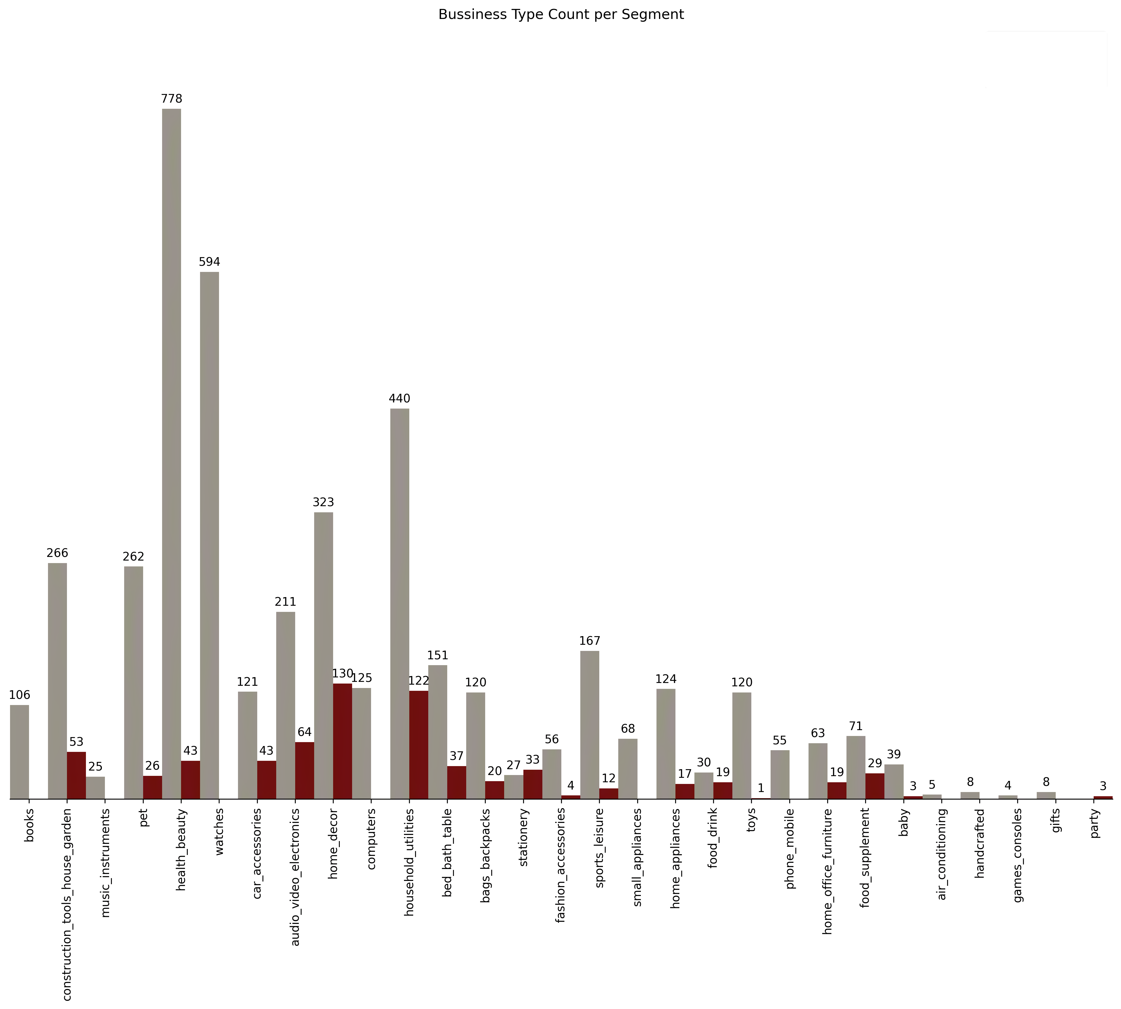
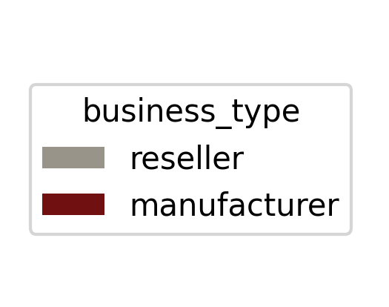
How do Sellers Compare across Business Types

Slide 11
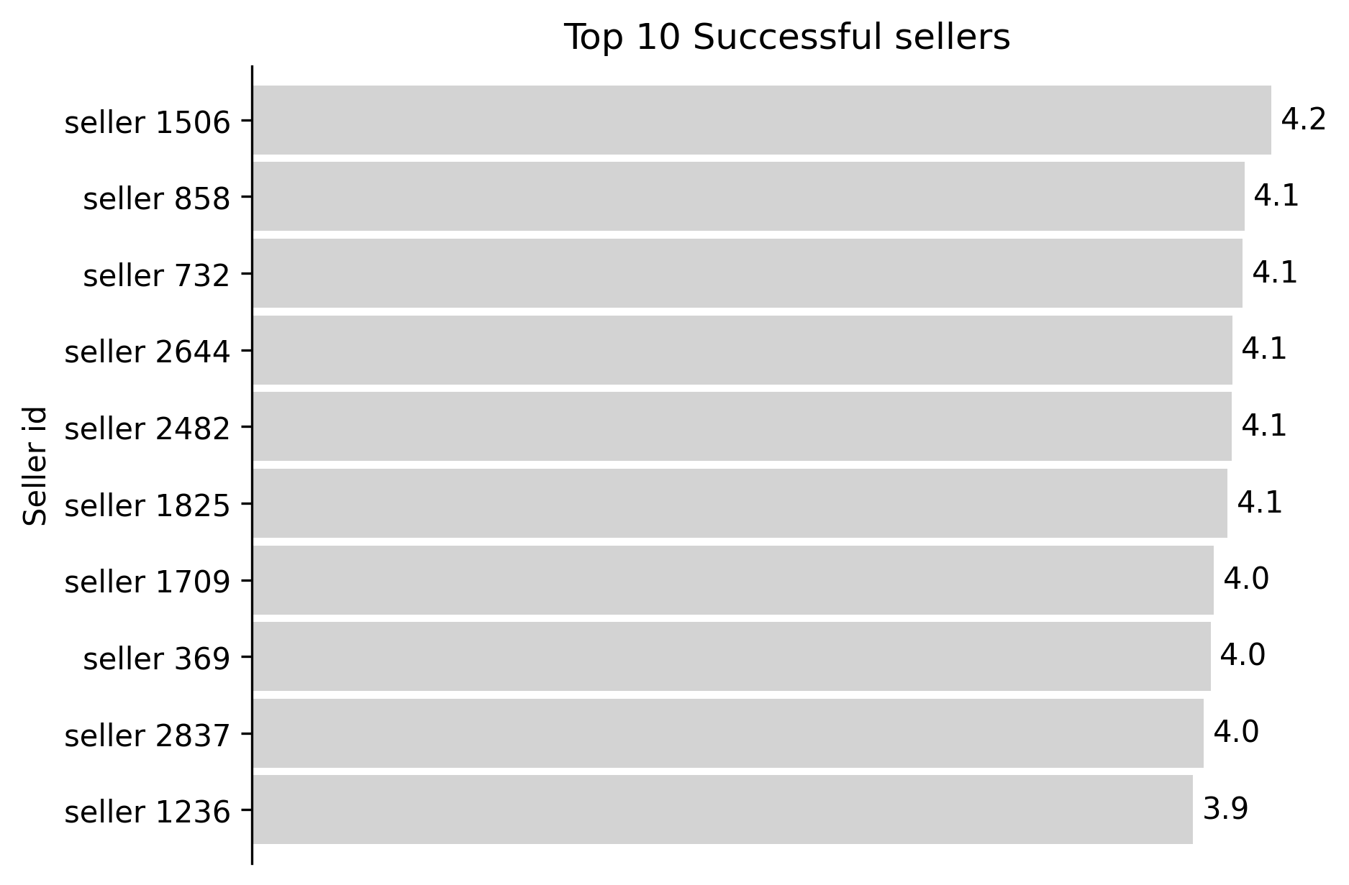



Who Are the Most Successful Sellers
Avg Score > 3.5 & Orders > 1000

Slide 12
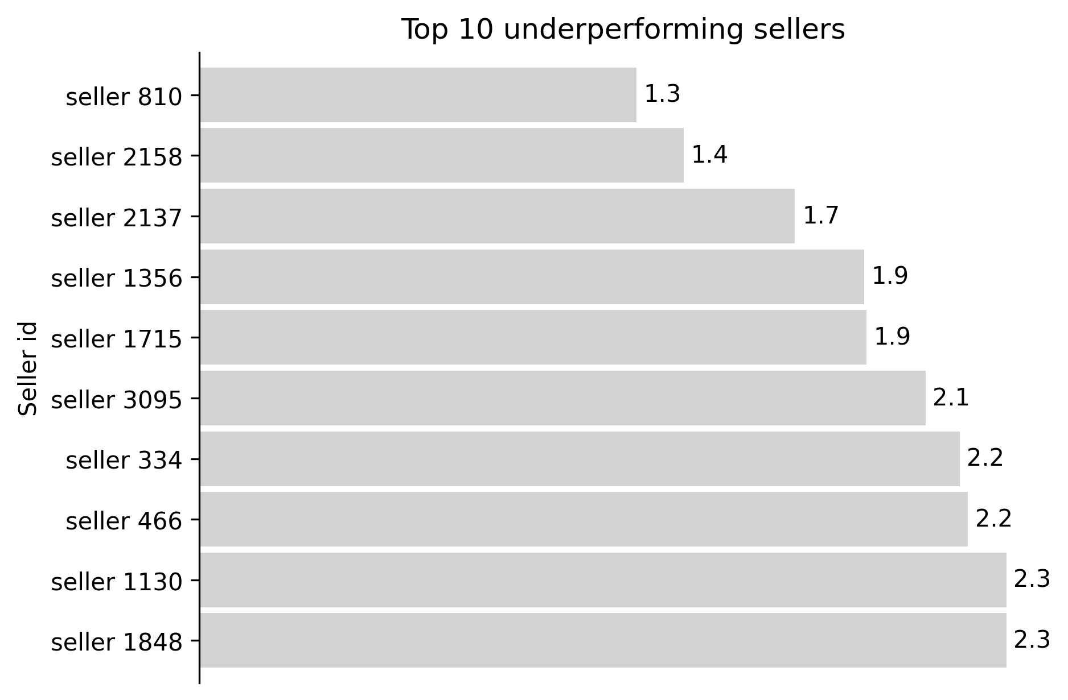

Who Are the Red Flages (Underperforming) Sellers
Avg Score < 2.5 & Orders <= 10

Slide 13
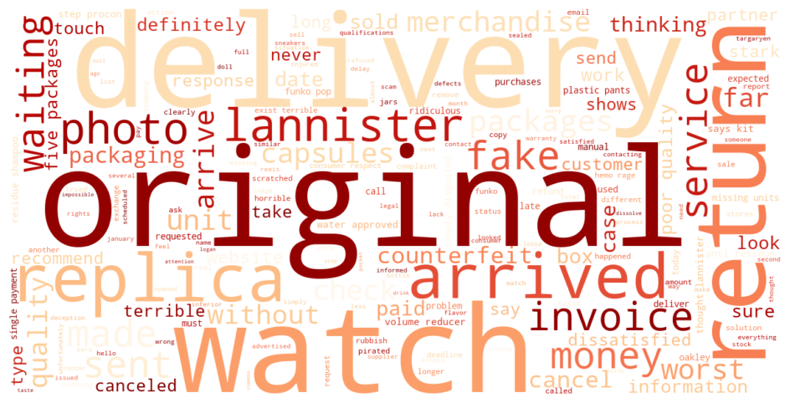
Low Rating Sellers Causes

Slide 14
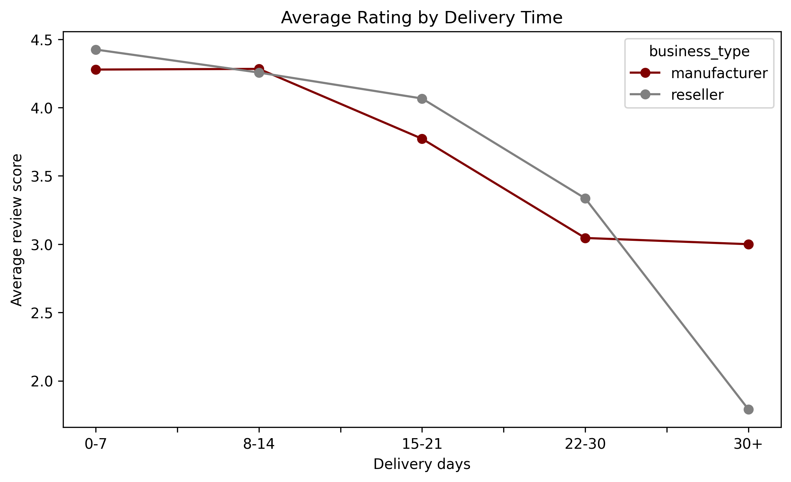
Shipping and Rating Correlations

Slide 15

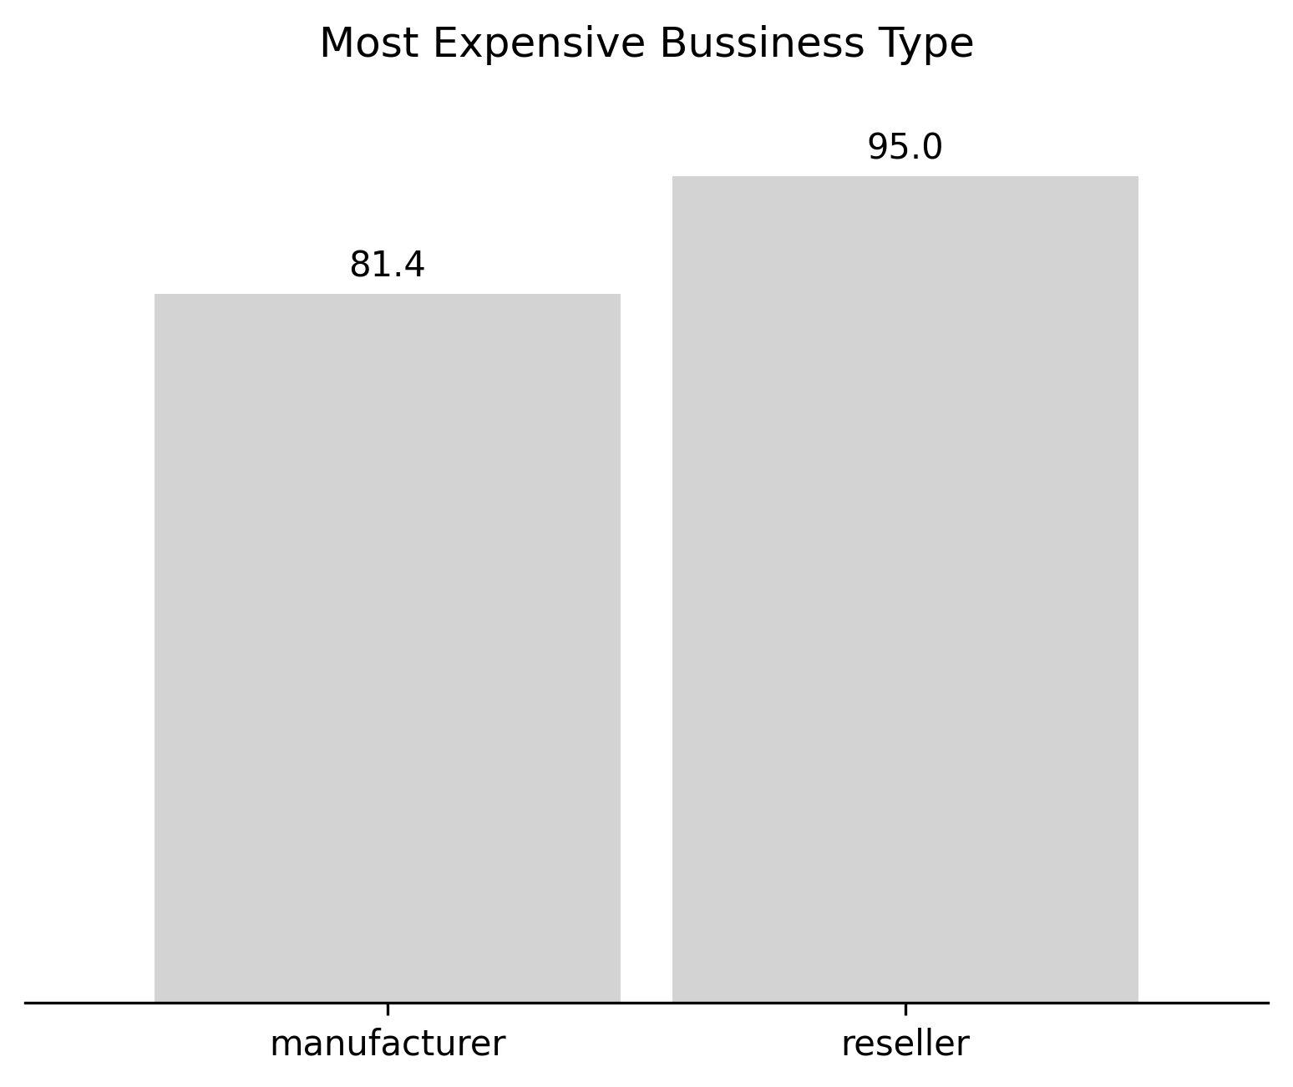
SPELLING Business
Median not mean?
Are Resellers More Expensive than Manufacturers?
The difference
14.4

Slide 16
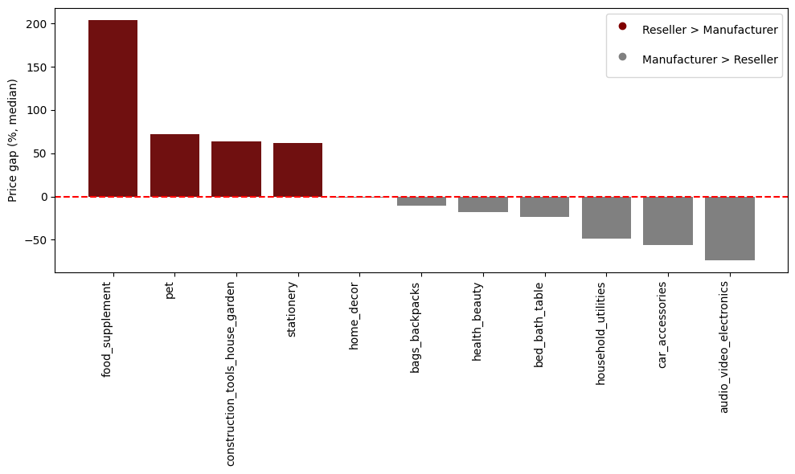
What is the price gap between resellers and manufacturers?

Slide 17
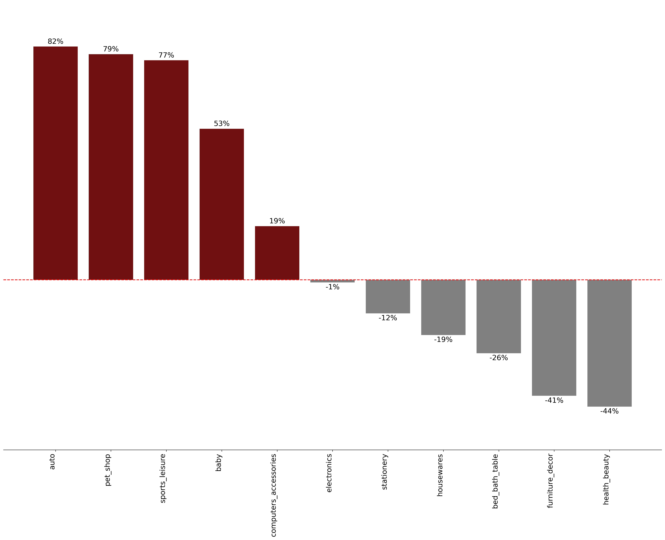


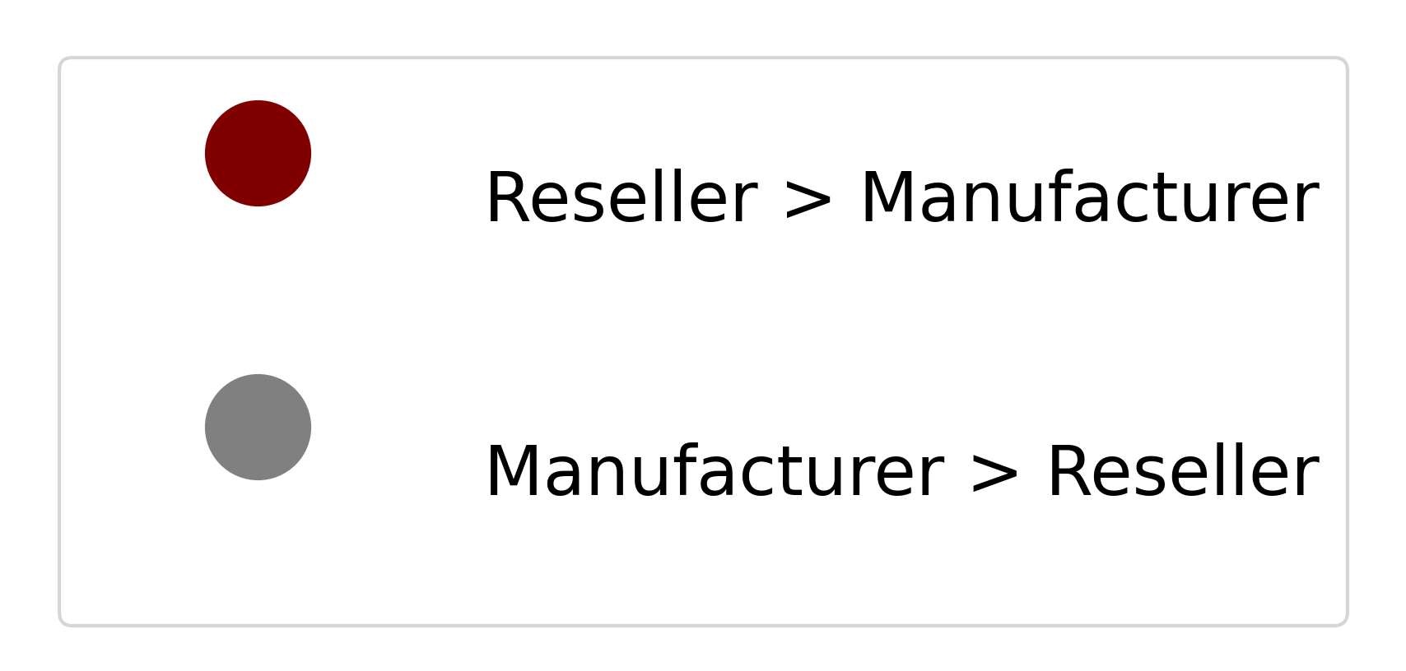

price markup of resellers compared to direct manufacturers

Slide 18




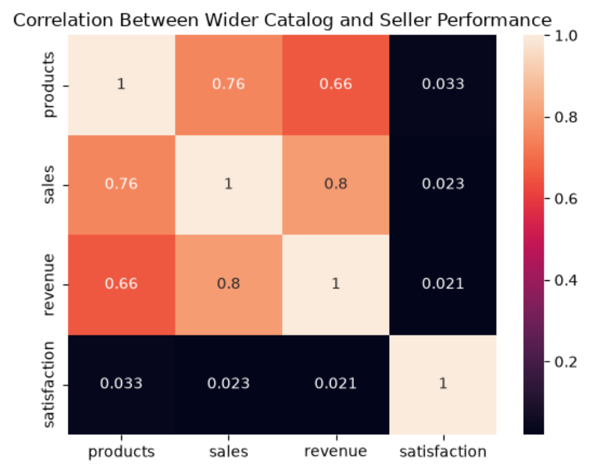
Wider Catalogs Drive Higher Seller Performance
Number of product
Number of Sales
Sum of Revenue

Slide 19

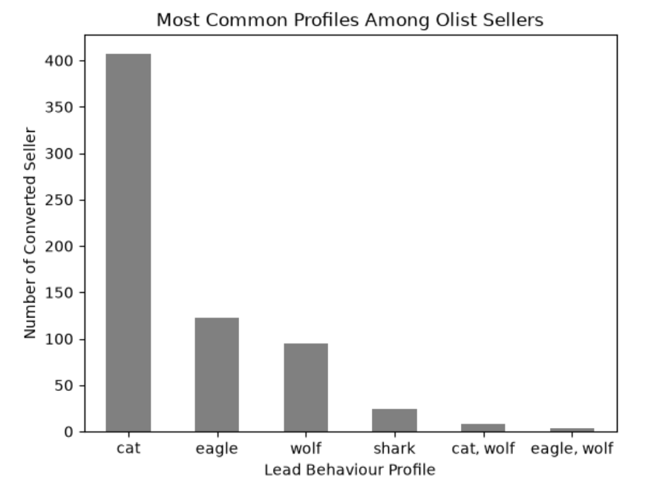
Olist Seller Profile

Slide 20
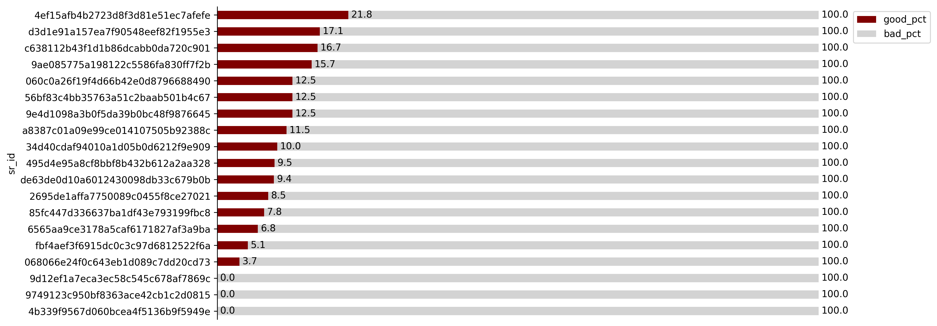
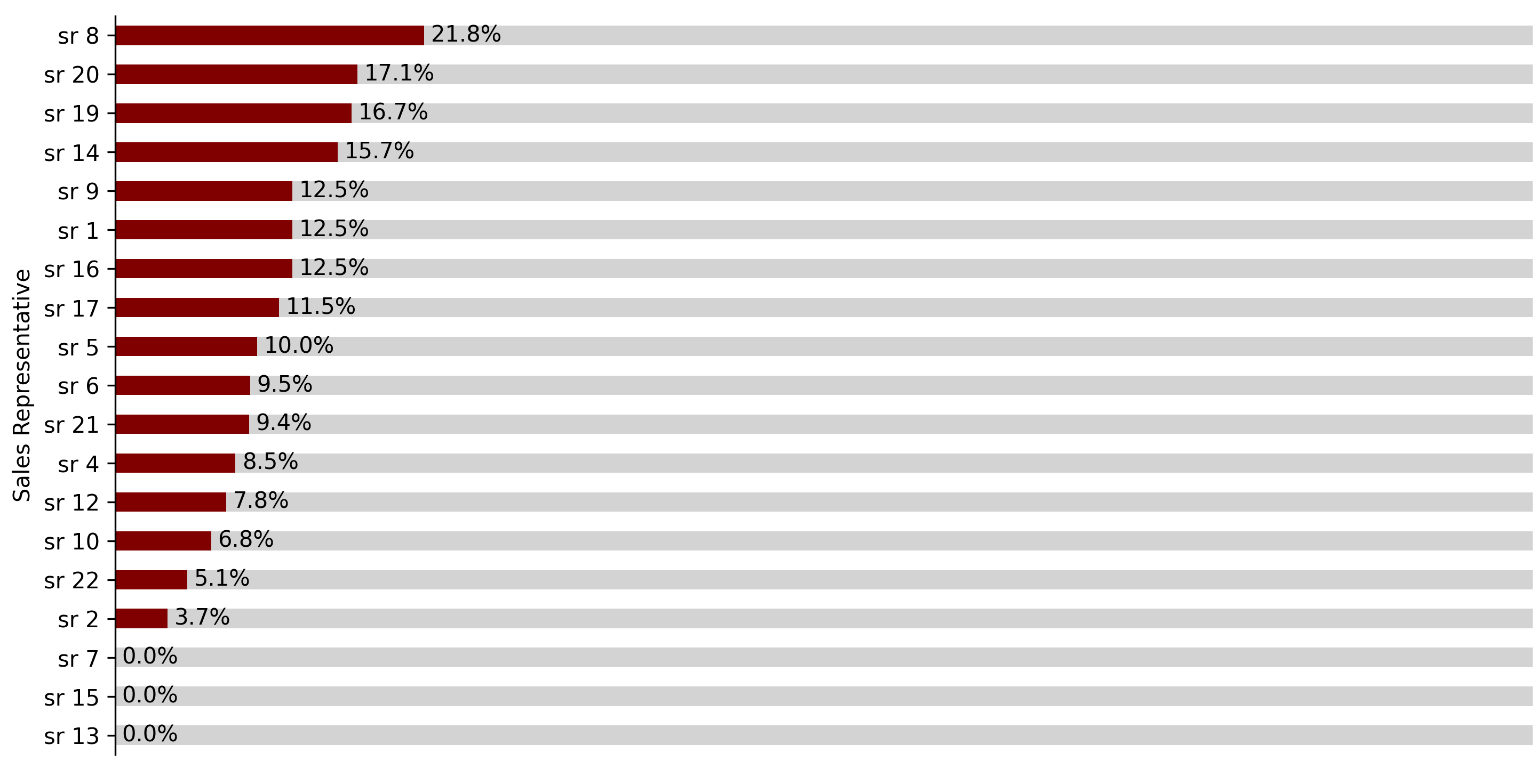
Are Employees Selecting the Right Sellers

Slide 21



Recommendations
Increase Seller Acquisition
Implement Rewarding System
Adjust Reseller Strategy
Support Sellers With Wider Catalog

Slide 22
Intelligent Seller Evaluation Model
Seller Conversion Prediction
Seller Performance Model
Input
Input
Origin, Business Type + Segment + Lead Profile
Sales, Revenue, Score, Complaints
Classification Model
Classification Model
Likely/Less to Convert
High Performance, Needs Attention, High Risk
Output
Output

Slide 23

Thank you
for listening!
  Fwen3@gmail.com
  +973 175##088
  Group3 - DSB3

